Slide 1
3rd Workshop Advanced use of the INSPIRE-SO Geopackage
Example of use through DBMS, R and Python.
Example of data loading from other databases /in other formats and structures using the hale studio

Slide 2
Outline
11:00 -11:30
Insights from the previous workshop
The Particle Size Fraction of the soil profile element
Example of use of the INSPIRE SO GeoPackage in DBMS, R, Python environments
11:40 -12:30
Example of data loading from other databases /in other formats and structures using the hale studio
Basic of hale studio
Upload data in the INSPIRE SO : simple example using sample data from LUCAS
12:40 – 13:00
Introduction to the next workshop
Soil codelists and vocabularies

Slide 3
Insights from previous workshop topics
Soil Profile Element and Particle size fraction
Example of use of the INSPIRE SO GeoPackage (DBMS, R, Python)

Slide 4
Soil Profile Element and Particle size fractions

Slide 5
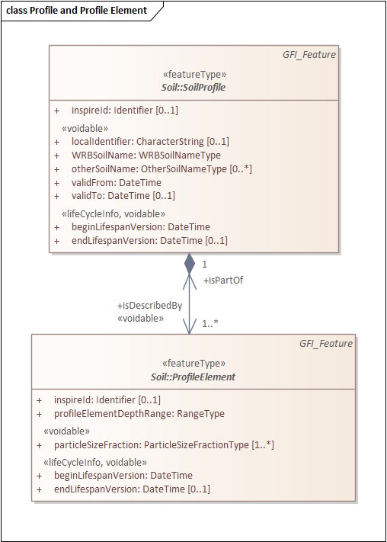
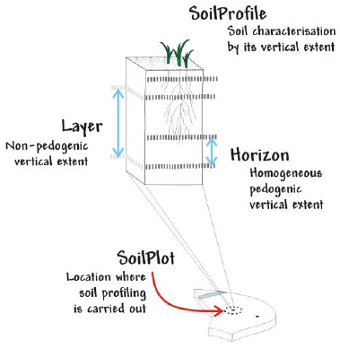
INSPIRE Profile Element
A Profile Element
is part of a Soil Profile.
is the general term to indicate both horizons and layers.
In the UML, it is an abstract class for grouping layers and /or horizons for functional /operational aims.

Slide 6
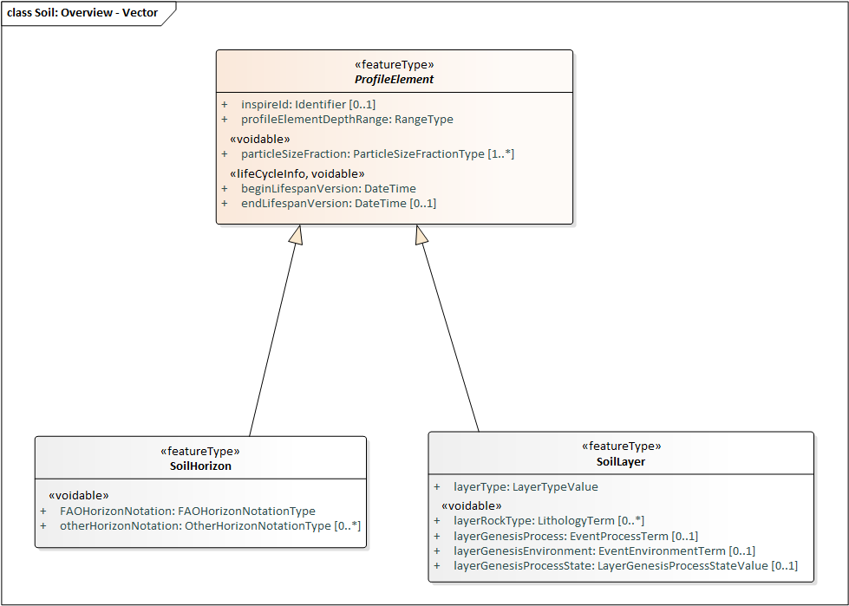
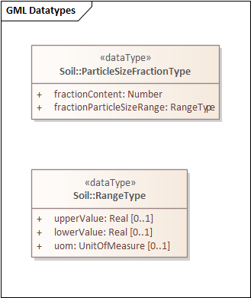
ParticleSizeFraction
Attribute of the Profile Element class.
Indicates how much of the soil material is composed of soil particles of a specified size range
percentage of the defined fraction.
upper and lower limit of the particle size of the defined fraction (expressed in µm)
EXAMPLE upper limit = 63µm , lower limit =20µm
Sum of the percentages of all the fractions should be 100%

Slide 7
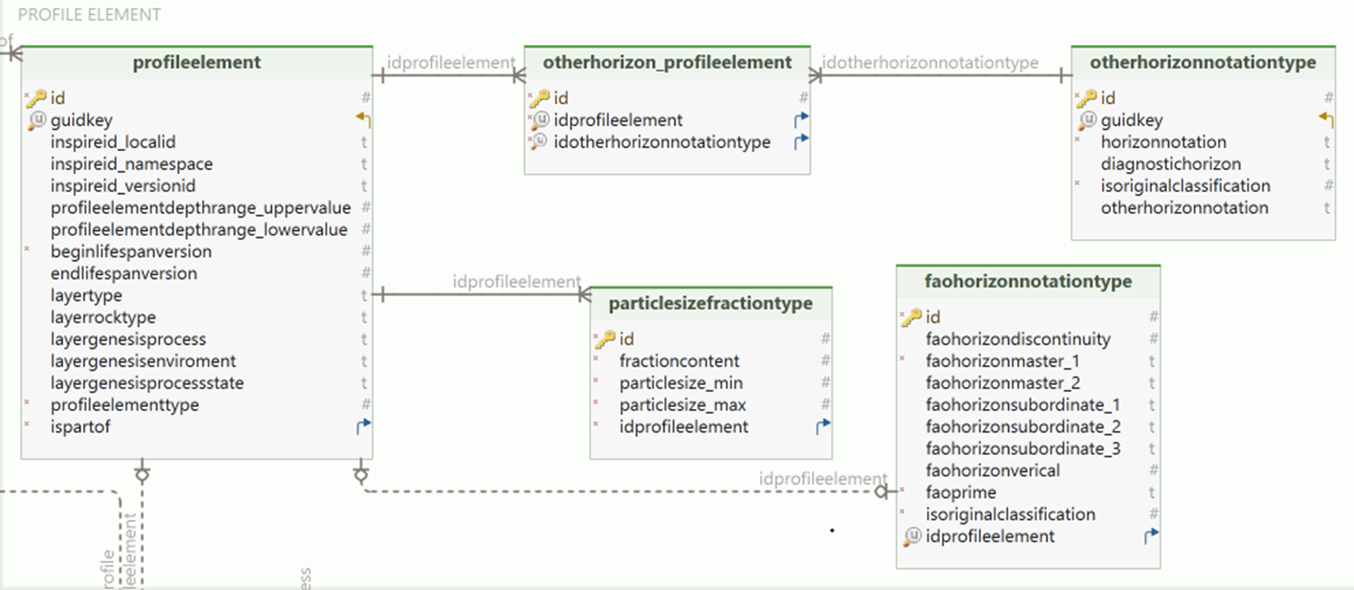
Particle Size Fraction in the INSPIRE SO GeoPackage
percentage
upper and lower limits
Same as INSPIRE!

Slide 8
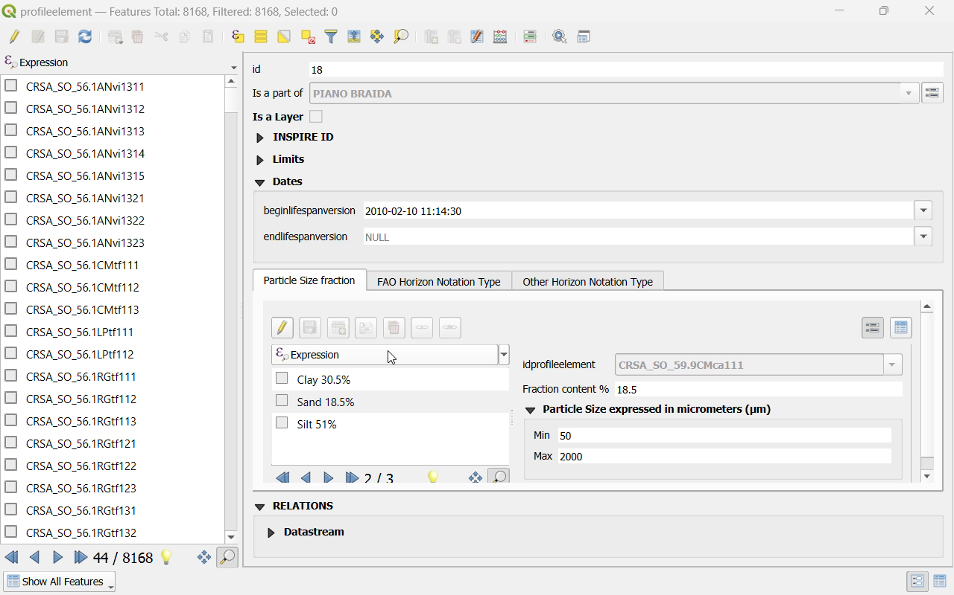


QGIS Style for Particle Size Fraction
To facilitate the reading of particle size fraction details, QGIS styles have been created.
QGIS Styles are custom-designed forms that assist users in consulting and entering data in a more human-readable format.
QGIS styles change the way data is presented to the user, but the data remains unchanged.

Slide 9
Example of use of the INSPIRE SO GeoPackage
DBeaver, R, Python

Slide 10



A simple example
GeoPackage format is well supported by mainstream software & tools
Exercise:
calculate Average Soil Depth by WRB Reference Soil Group for the data in INSPIRE SO

Slide 11



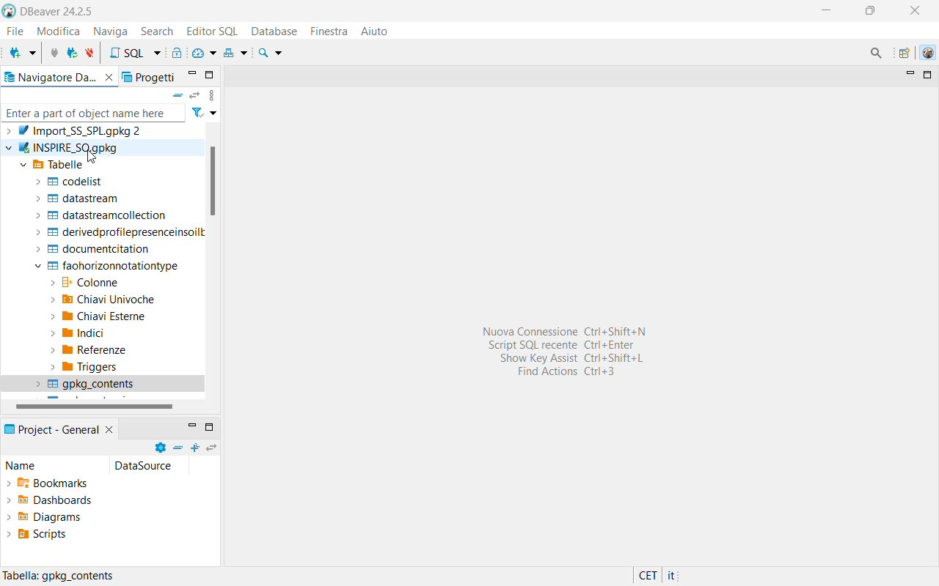
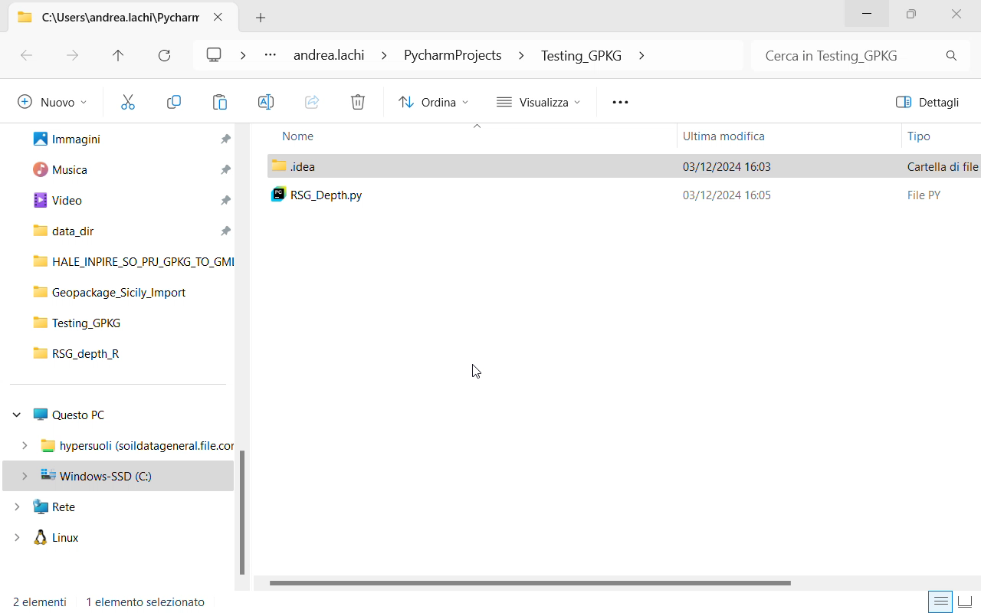
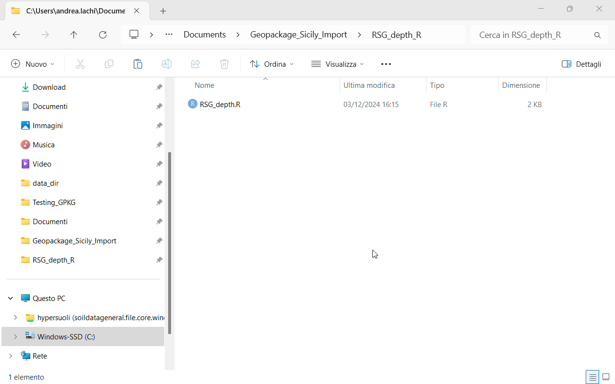
A simple example
Python script
R script
SQL Query
library(RSQLite)
library(gpkg)
My_Geop <-gpkg_list_tables("C:/.../INSPIRE_SO.gpkg")
import sqlite3
gpkg_path = "C.../INSPIRE_SO.gpkg"
SELECT column1, column2, column3
FROM table_name
WHERE condition
GROUP BY column1
HAVING aggregate_condition
ORDER BY column2 ASC;

Slide 12





Work in progress
create.sql
create_PostGis.sql
</>
</>
STYLES
Portable
Server

Slide 13

Coffee Break
Q&A

Slide 14
Example of data loading
from other databases /in other formats and structures using hale studio

Slide 15
Simple example using sample data from LUCAS
Following is a simple demo to show how data of different format/structure can be loaded into the GeoPackage using a data transformation tool.
Exercise:
import sample soil plots and associated OC observations from LUCAS into the INSPIRE-SO GeoPackage using hale studio

Slide 16
Physiochemical Measurements in INSPIRE Soil
Brief recap from workshop 1

Slide 17
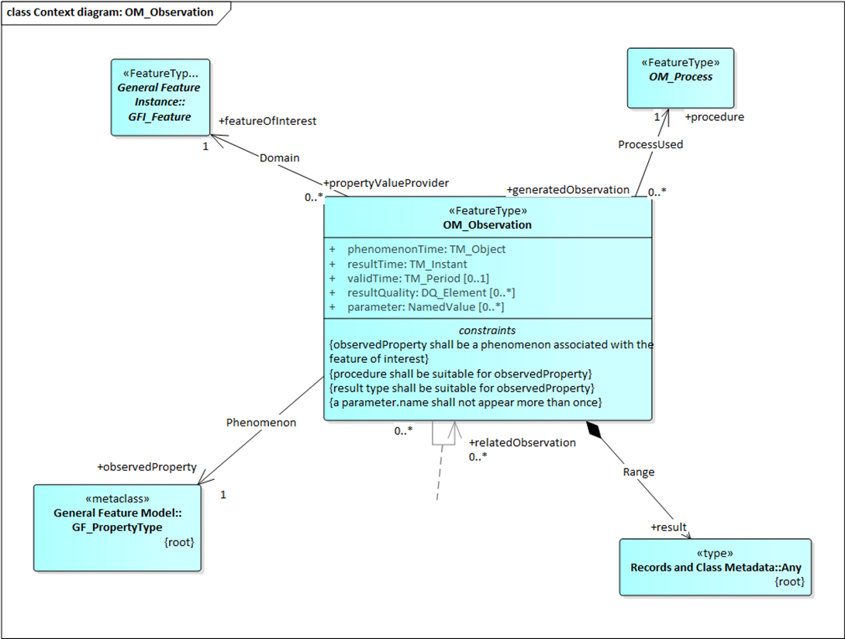
Physiochemical Measurements
Physiochemical measurements on soil objects are modeled through O&M observations.
Physiochemical Measurements
physical -e.g. textural class, percent clay/ silt/ sand ….
chemical e.g. OC, pH, Ca
Soil objects:
sites, plots, profiles, profile elements (layers & horizons)
O&M

Slide 18
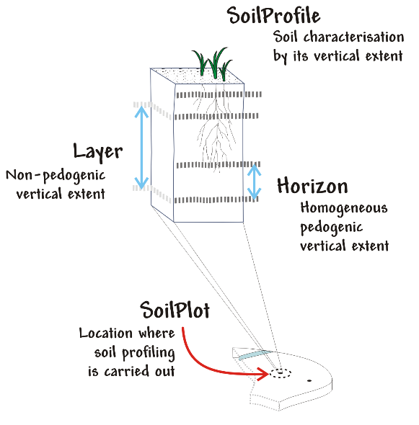
Physiochemical Measurements via O&M
Organic Carbon Content
Layer
Percentage by mass
Feature
ObservableProperty
uom
featureOfInterest
observedProperty
Observation
procedure
result
Process
Value
ISO 10694:1995
16.2

Slide 19
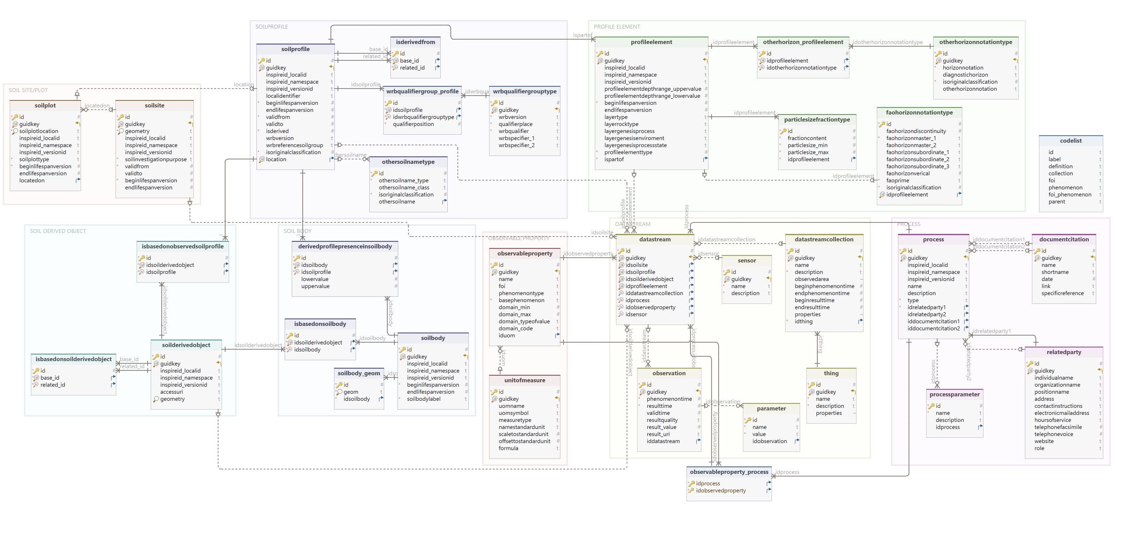
INSPIRE SO GeoPackage: tables addressed in the exercise

Slide 20
hale studio ETL tool

Slide 21

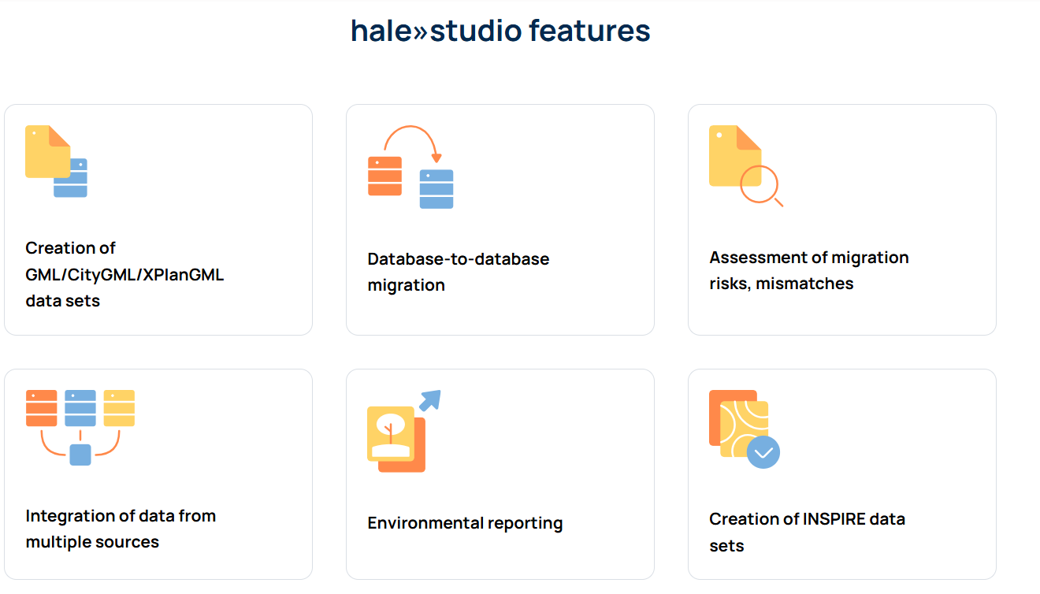
hale studio ETL tool
“Extract, Transform, Load” (ETL) tool for data transformation.
Open-source
Designed for transformation of large and complex data sets.
Supports schema validation, user-friendly GUI for interactive mapping, command-line interface for automation.

Slide 22
hale studio typical workflow
Import the source and target schemas
Import source data (optional, needed to enable 'live' validation )
Identify relationships between source and target types
Add identified relationships to the alignment panel
Export data transformed in desired format & structure (GeoPackage /GML / database tables/ GeoJSON...)

Slide 23
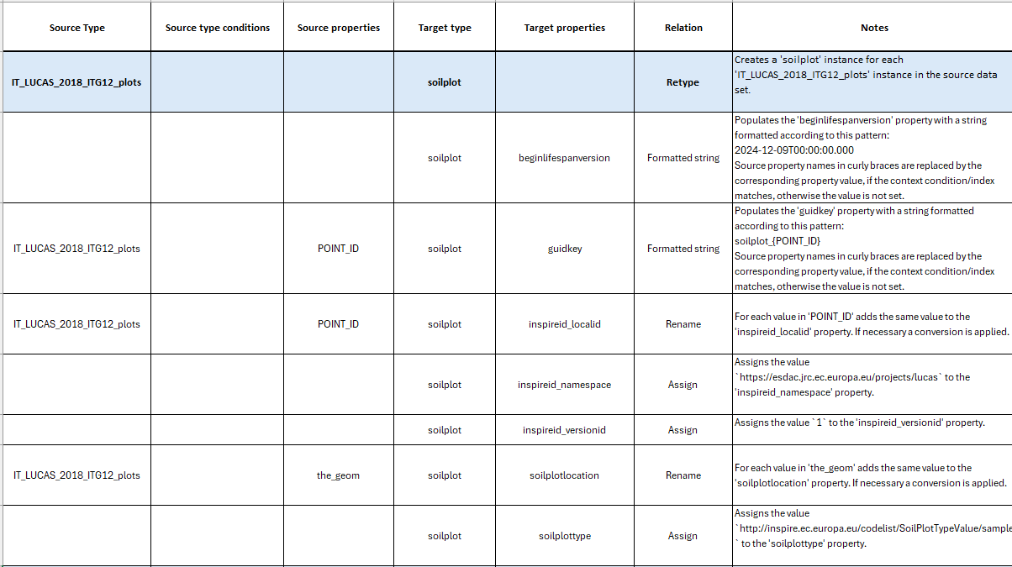
Mapping Table
As support for the creation of the hale studio project, it is recommended to create mapping tables to already identify:
relationships between properties of the source and the target
rules for the creation of specific properties
possible information gaps
possible pre-processing activities.

Slide 24
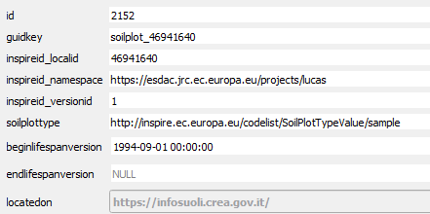
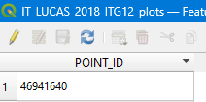
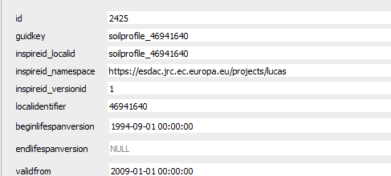
Rule for the creation of guidkey
soilplot
In the INSPIRE SO the ‘guidkey’ column is used as foreign key → is essential to link tables to one another
Establish a rule to create ‘guidkey’ for soil plots, soil profiles, soil profile elements.
It was decided create them from the plot identifier (PointID) from the LUCAS shapefile prefixing it with the feature name
soilprofile

Slide 25
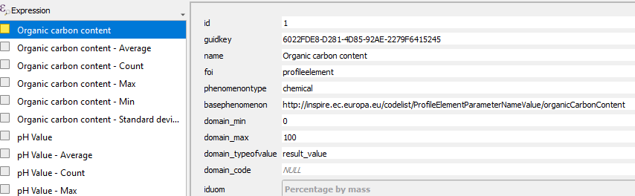
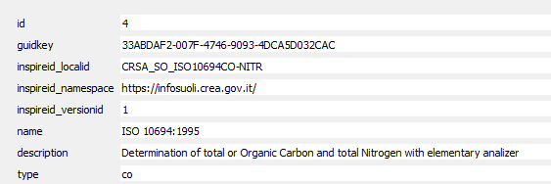
Pre-processing
Observed property
Get the ‘guidkey’ values for
Observed Property = Organic Carbon
Process= ISO 10694:1995
Process

Slide 26
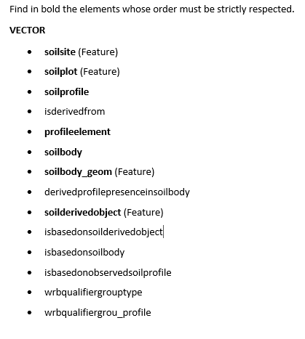
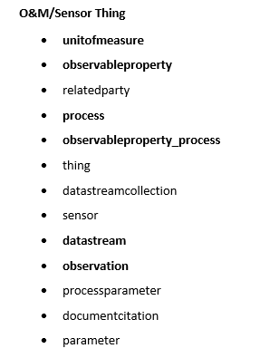
INSPIRE SO: Data loading order
To maintain data integrity and for content validation purposes, the INSPIRE SO contains triggers.
Triggers are stored procedures that are automatically executed in response to certain events, such as INSERT, UPDATE or DELETE operations on a particular table or view.
Triggers and foreign key constraints require data to be loaded in a specific order.

Slide 27
LIVE DEMO

Slide 28
hale studio advanced features
In the demo we illustrated how the OC observations from LUCAS source are associated with related soil profile elements.
To associate e.g., PH observations by using hale studio out-of-the box functions, we would need to re-run the project using the PH field instead of the OC… and so on for all the properties.
However, it is possible to associate the observations for all the observed properties with the related layers in a single shot, but we would need to use advanced Hale options.
Specifically, we would need to write Groovy Script code

Slide 29
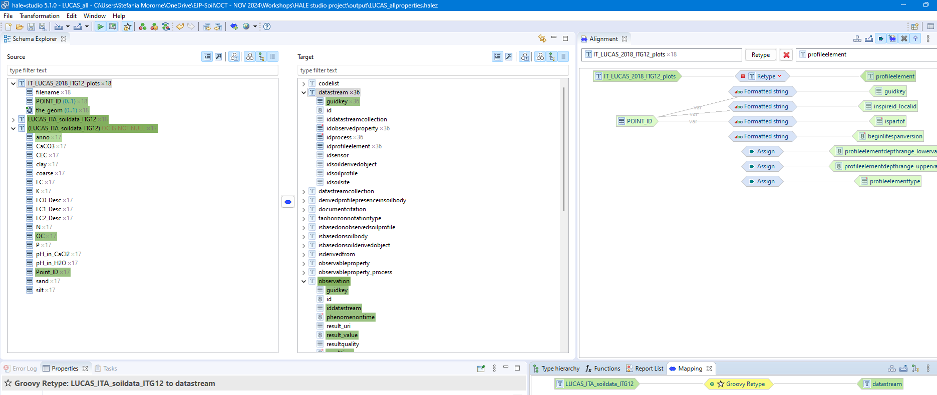
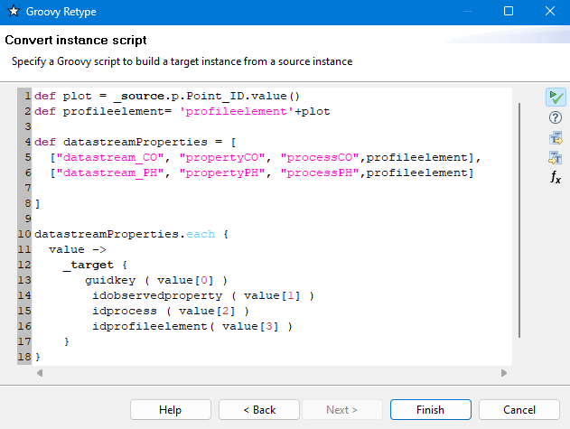
Groovy script example

Slide 30
Q&A

Slide 31
Introduction to the next workshop

Slide 32
Thanks for your attention!
We hope to see you at the 4th Workshop
13 January 2025, 11.00 to 13.00 am, CET time zone.
Recordings will be available on EJPSOIL YouTube channel https://www.youtube.com/@ejpsoil6391
The presentation will be shared on the EJP SOIL website https://ejpsoil.eu/soil-research/soil-data-monitoring-mapping-and-modelling
For questions: andrea.lachi@crea.gov.it, s.morrone@epsilon-italia.it maria.fantappie@crea.gov.it, giovanni.labate@crea.gov.it

